Slide 1

MANGIA TRANQUILLO
CECCHETTO ALESSANDRO
SINIGAGLIA DANIELE
VISOTTO MATTEO

Slide 2
SERVICE DESCRIPTION
MangiaTranquillo is a service that allows people hospitalized to be able to choose food from a menu tailored to their needs
By connecting to the NHS, the service filters the hospital menu by taking into account each patient's dietary restrictions

Slide 3

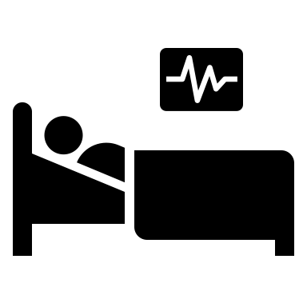


OVERVIEW
Ease the workload on health workers
Allow the patients to choose food consistent with his medical record and his ethical diet
H

Slide 4
WHAT WE HAVE DONE
Archimate Modeling
Business Process Choreography
Business Process Orchestration
Soundness Checks
Design and implementation of 3rd-party APIs
Executable Process

Slide 5
ARCHIMATE MODEL
Archimate is a language for enterprise architecture modelling to support the description analysis and visualization of the architecture within and across business domain.
The goal of the Archimate model is to define the process at high level of granularity, how the consumer is connected to the enterprise and how the processes are related

Slide 6
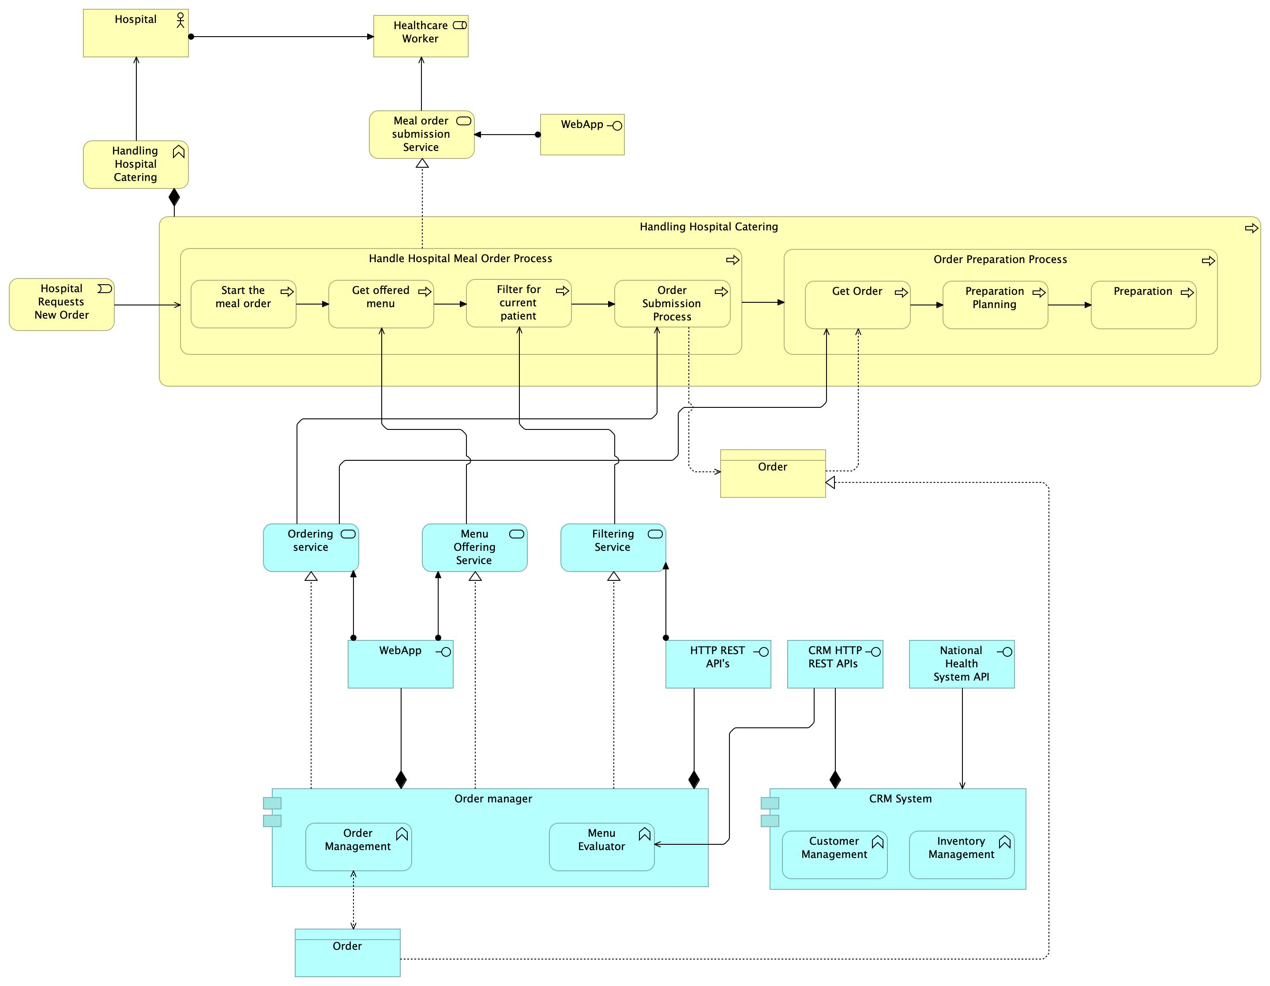
ARCHIMATE MODEL
Model consist of three services:
Ordering service
Menu Offering Service
Filtering Service

Slide 7

ORCHESTRATION
Orchestration concerns the management of activities executed under a common controlling element (the orchestrator). Usually, the boundary of an orchestrator is an organization.
The orchestrator controls the execution of the business process according to a control-flow model. The control-flow is usually modelled based on a set of patterns.

Slide 8
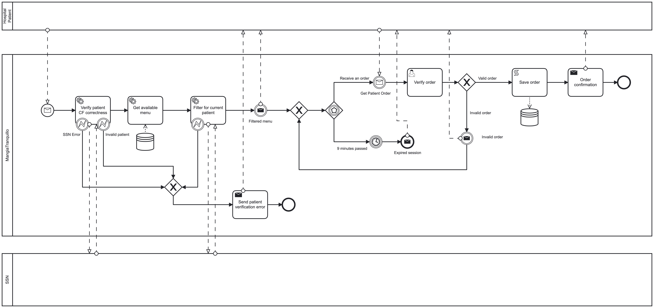
ORCHESTRATION (1)

Slide 9
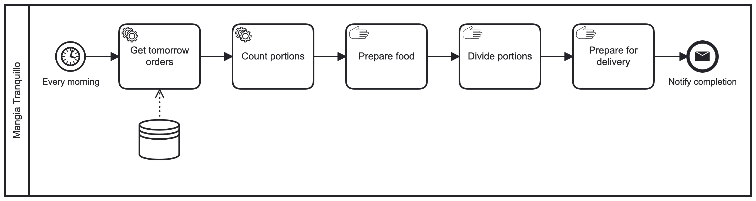
ORCHESTRATION (2)

Slide 10
CHOREOGRAPHY
The choreography diagram provides a high-level perspective focused only on the relationships among the organization, but without specifying the internal processes.
It does not take the standpoint of any of the participants and typically is the base from which the collaboration diagram is derived.

Slide 11
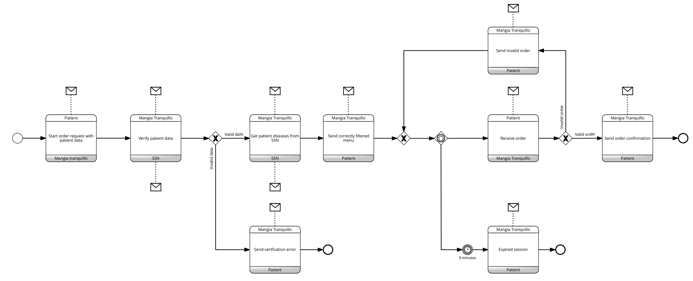
CHOREOGRAPHY
Interaction begins with the receipt of data from the patient. These data are forwarded to the national health system, which verifies their correctness. If the data are valid, the SSN sends the application dietary restrictions derived from diseases that the patient presents and the clinical history. From these, MangiaTranquillo presents the hospital menu filtered according to need. The patient can then proceed with ordering, and a confirmation message is returned

Slide 13
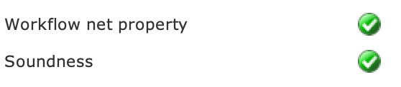
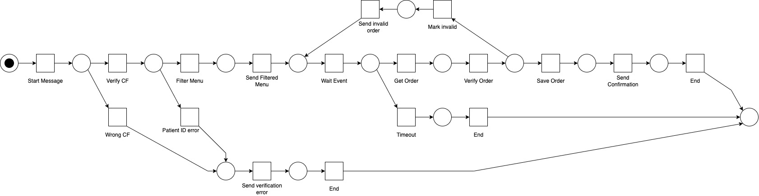
SOUNDNESS
Soundness is a property that allow to identify correct WF-nets and so business processes.
A WF-Net (corresponding to a BP) is sound if and only if: for any case, the procedure will terminate eventually, and at the moment the procedure terminates there is a token in place ‘o’ (the final place) and all the other places are empty.

Slide 14



IMPLEMENTATION
The business process is executed into Camunda Platform
Service tasks are implemented by means of external resources using camunda-external-task-client-js for node.js
The integration between the business process and the 3rd party APIs has been made by means of rest calls between the worker and the rest server generated from OpenAPI specification with Swagger.

Slide 15
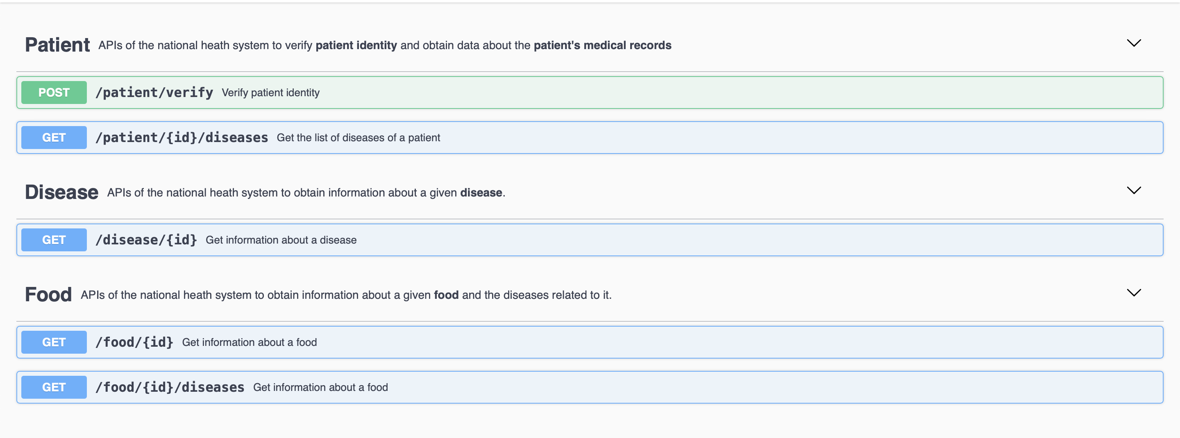
REST API

Slide 16
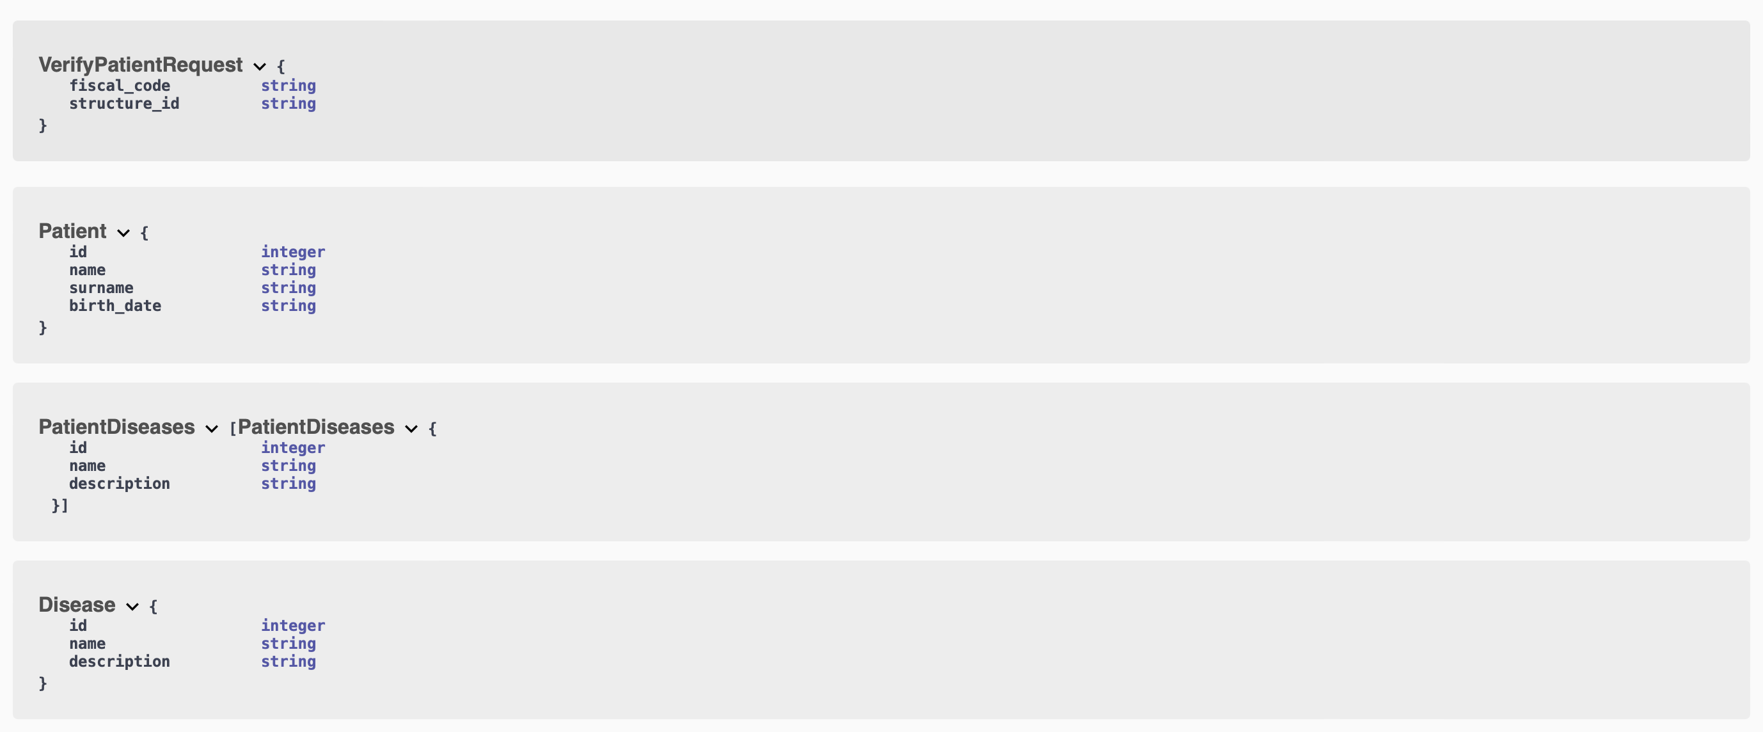
SCHEMA (1)

Slide 17
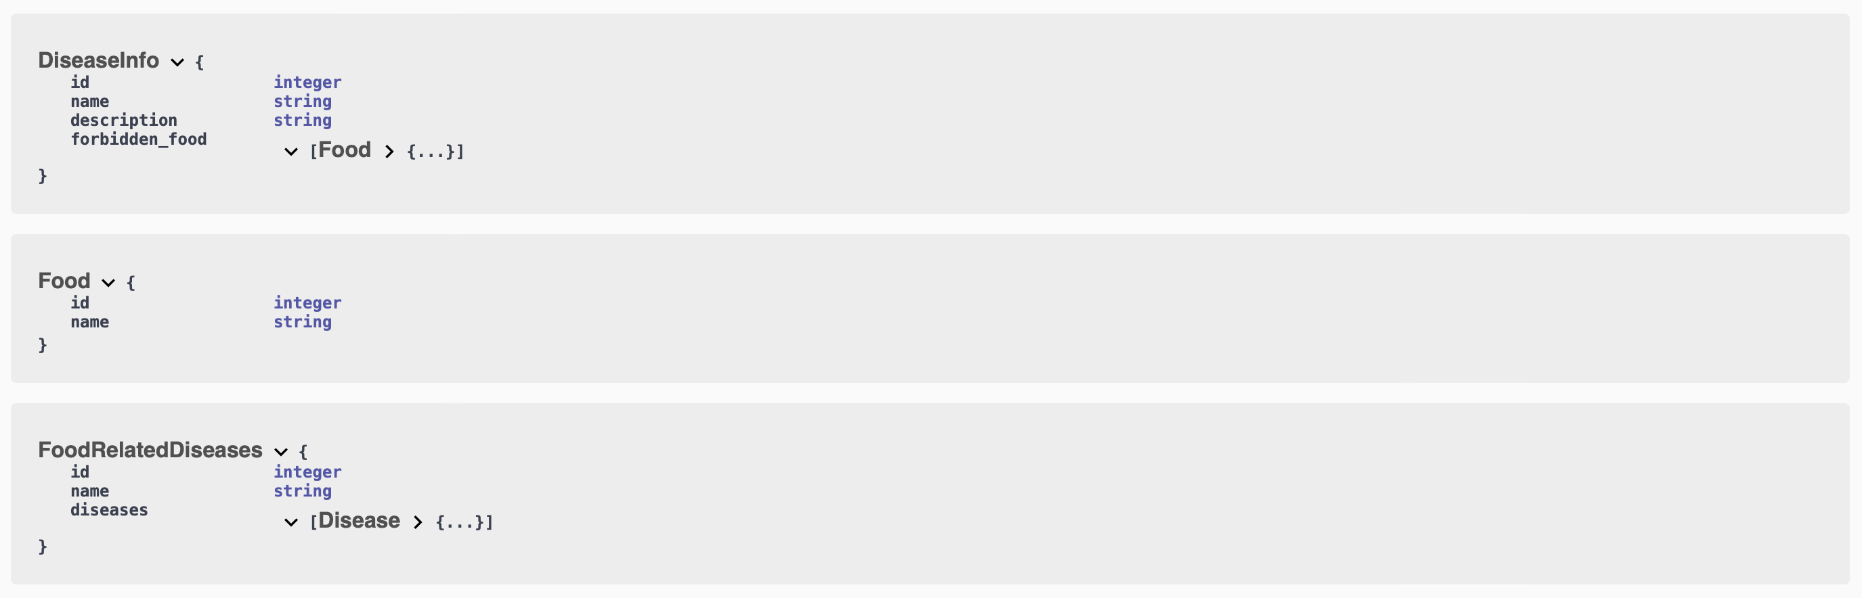
SCHEMA (2)

